Slide 1
This powerpoint file contains a summary repertory of the models available with the QNM solver QNMEig.
If you develop your own models with the solver and wish to make them available, you may propose a summary with the reference to the original publication and your email address, so that potential users may contact you directly.
Please address your ppt summary sheet to philippe.lalanne@institutoptique.fr
plasmonic nanocavities ……………………………………………………… p 2
photonic microcavities & particles ..……………………………………. p 9
gratings and crystals ……………………………………………………..…… p 13

Slide 2
plasmonic nanocavities

Slide 3
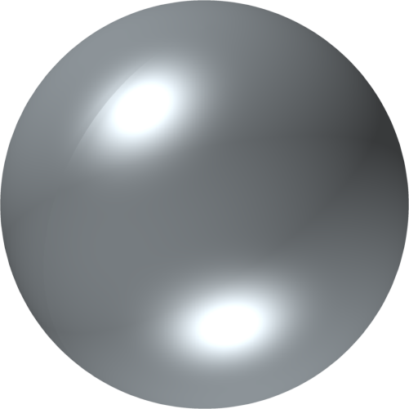
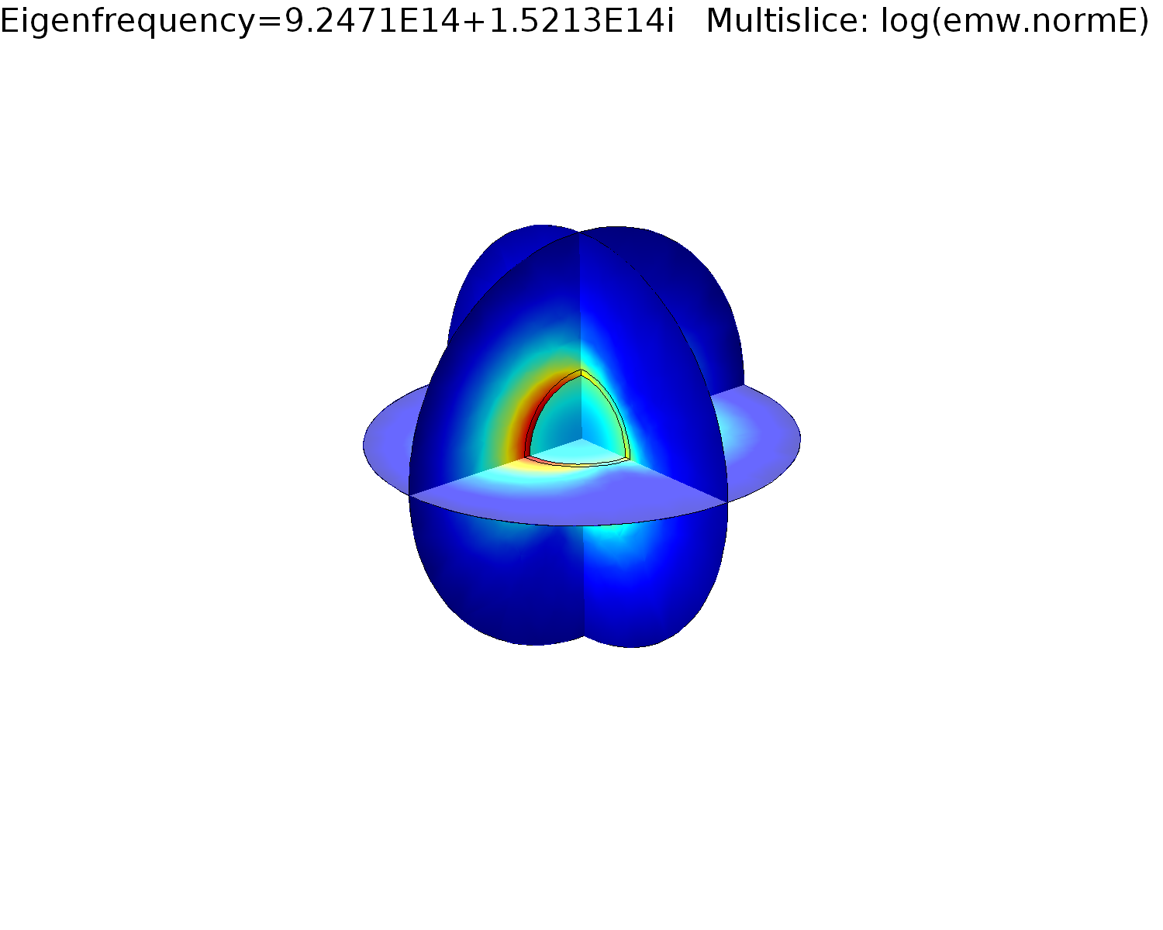
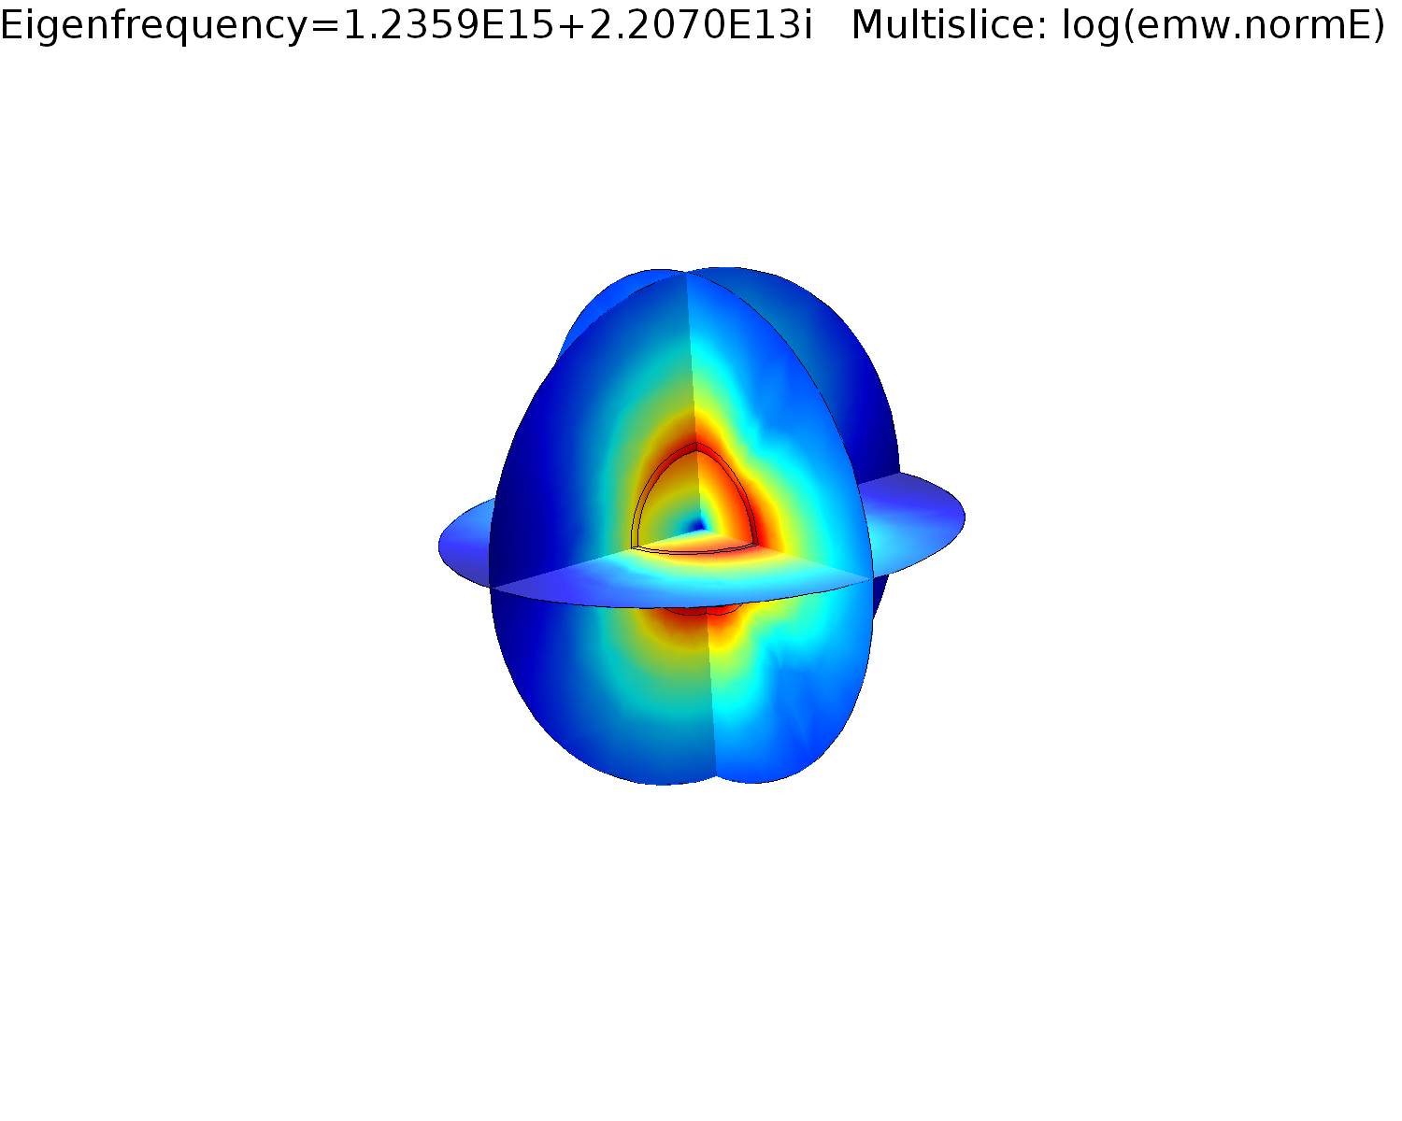
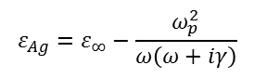
$$ε_{Ag}=ε_{∞}−\frac{ω_{p}^{2}}{ω\left(ω+iγ\right)}$$
Silver sphere in air
Contact: Wei Yan <yanwei@westlake.edu.cn>
Ag
COMSOL model available on the website:
“QNMEig_Sphere.mph’’
air
W. Yan , R. Faggiani, P. Lalanne, Phys. Rev. B 97, 205422 (2018).
"Rigorous modal analysis of plasmonic nanoresonators"
Notes:
Developed by Wei Yan (2018)

Slide 4
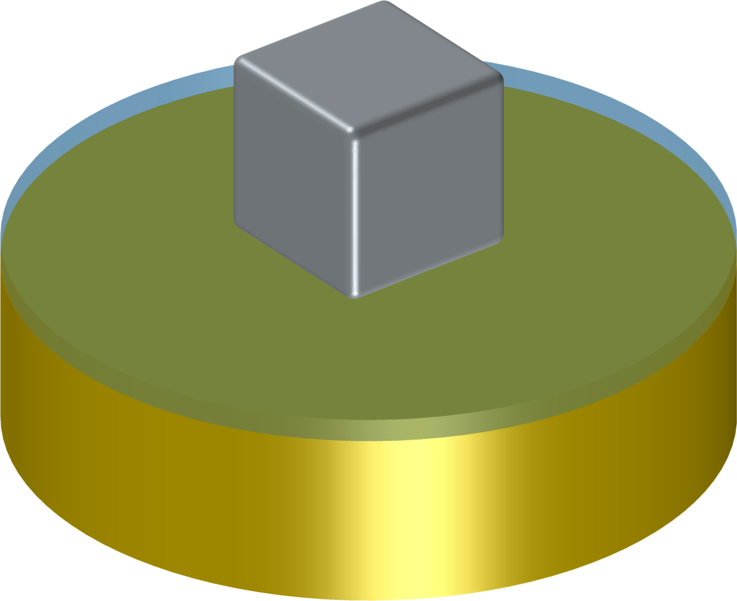
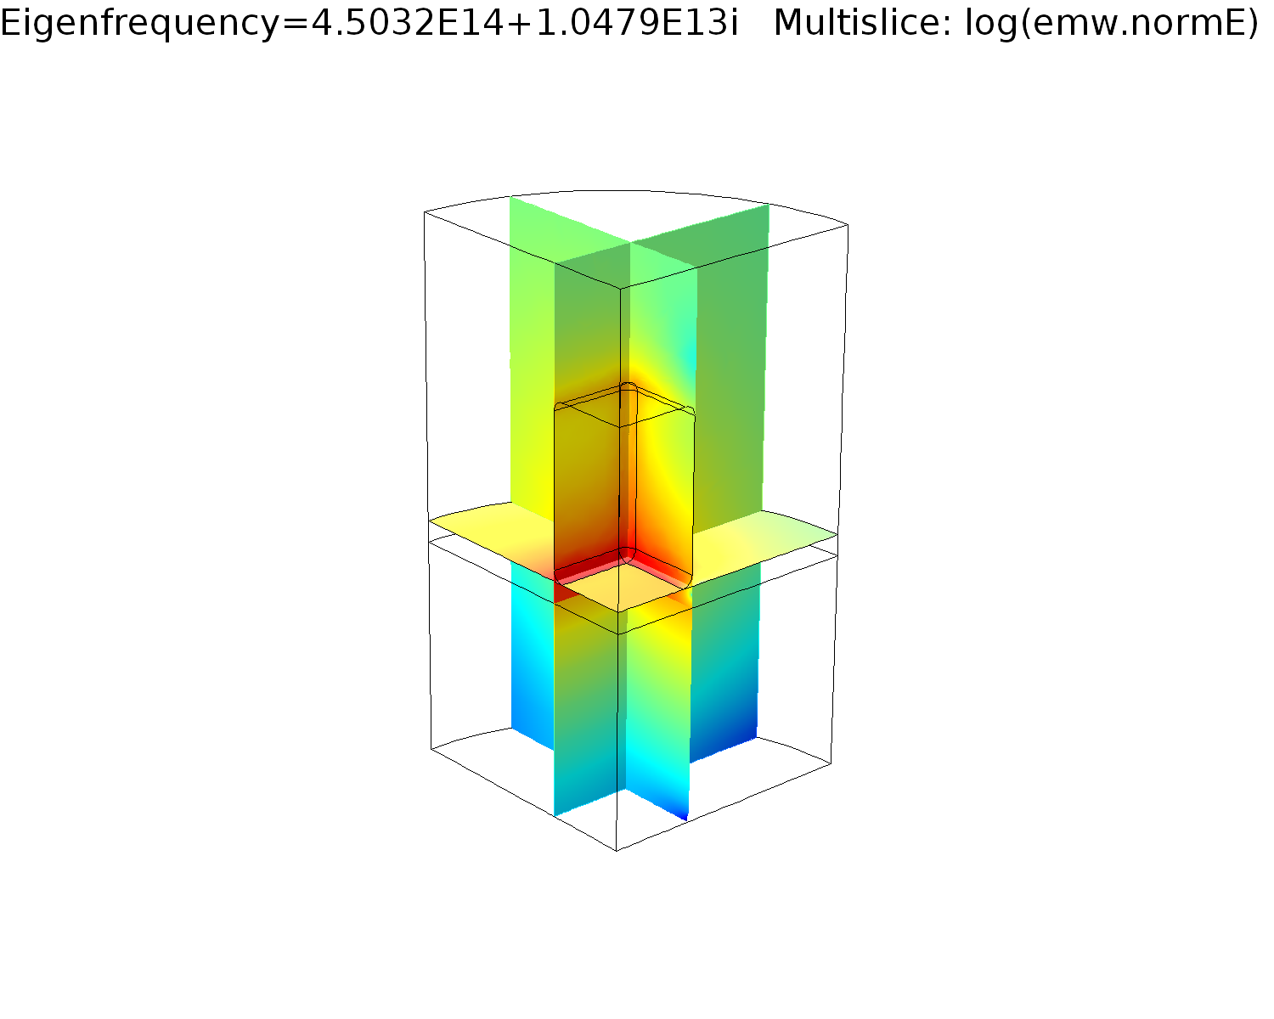
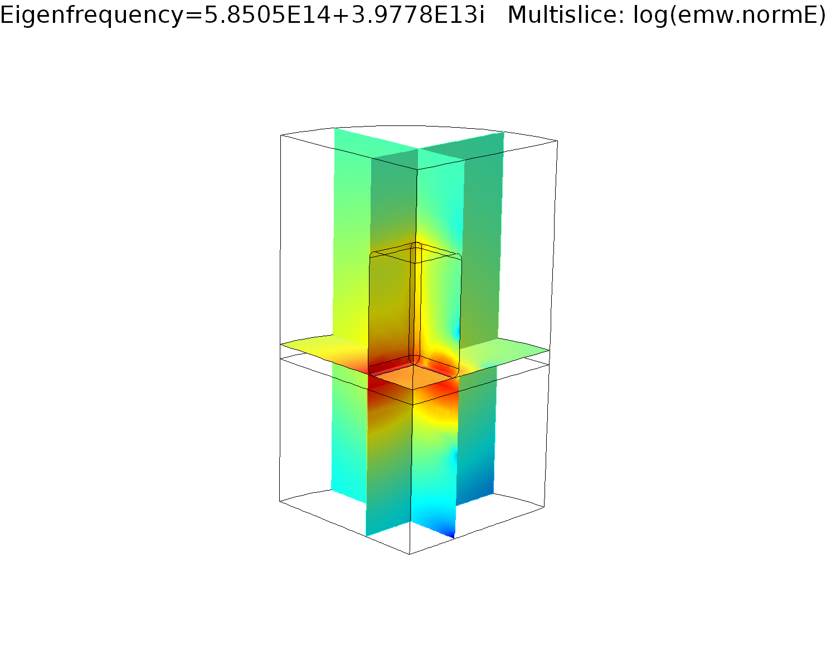
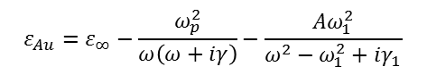
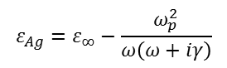
$$ε_{Ag}=ε_{∞}−\frac{ω_{p}^{2}}{ω\left(ω+iγ\right)}$$
Silver nanocube on a coated gold substrate
Ag
Contact: Wei Yan <yanwei@westlake.edu.cn>
COMSOL model available on the website:
“QNMEig_Cubesubstrate.mph’’
Au substrate
thin insulator layer
$$ε_{Au}=ε_{∞}−\frac{ω_{p}^{2}}{ω\left(ω+iγ\right)}−\frac{{Aω}_{1}^{2}}{ω^{2}−ω_{1}^{2}+iγ_{1}}$$
nanocube in air
thin layer
Au substrate
P. Lalanne, W. Yan, A. Gras, C. Sauvan, J.-P. Hugonin, M. Besbes, G. Demesy, M. D. Truong, B. Gralak, F. Zolla, A. Nicolet, F. Binkowski, L. Zschiedrich, S. Burger, J. Zimmerling, R. Remis, P. Urbach, H. T. Liu, T. Weiss, J. Opt. Soc. Am. A 36, 686 (2019).
"Quasinormal mode solvers for resonators with dispersive materials"
Notes:
Developed by Wei Yan (2018)

Slide 5
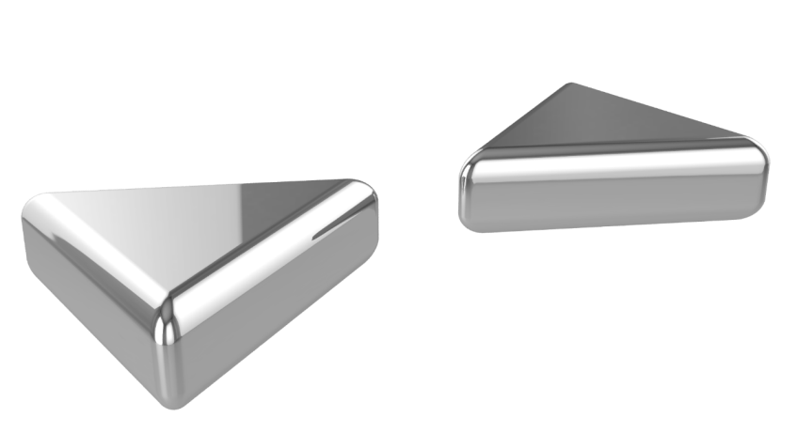
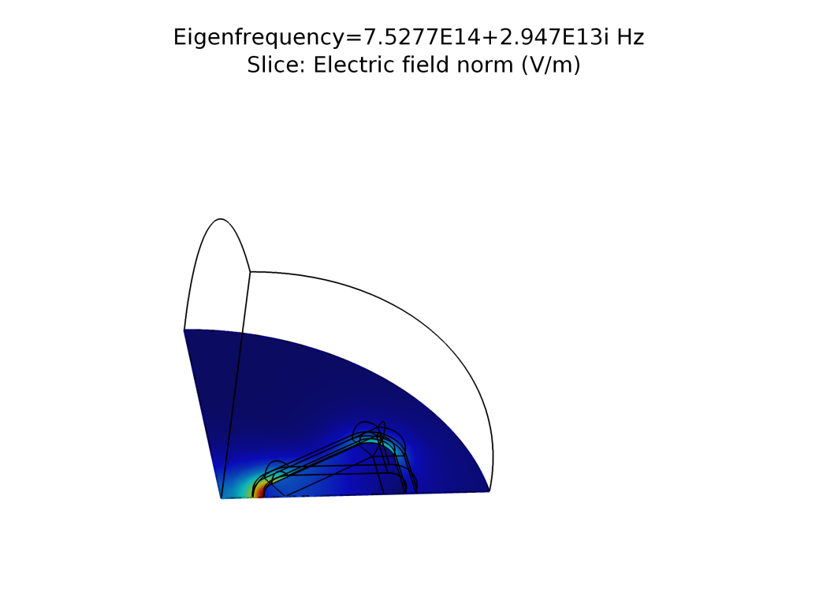
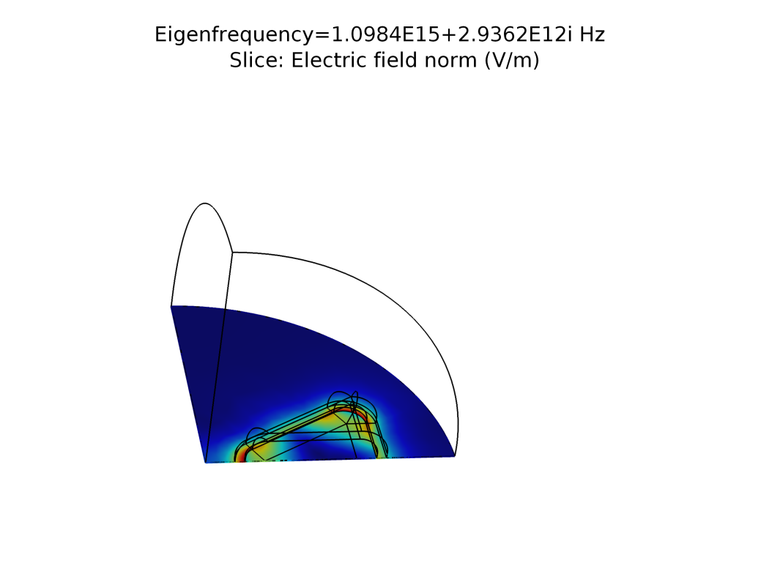
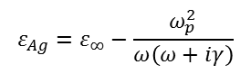
Silver bowtie in air
air
Ag
Contact: Wei Yan <yanwei@westlake.edu.cn>
$$ε_{Ag}=ε_{∞}−\frac{ω_{p}^{2}}{ω\left(ω+iγ\right)}$$
COMSOL model available on the website:
“QNMEig_bowtie.mph’’
W. Yan , R. Faggiani, P. Lalanne, Phys. Rev. B 97, 205422 (2018).
"Rigorous modal analysis of plasmonic nanoresonators"

Slide 6
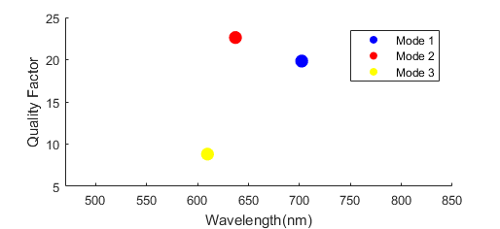

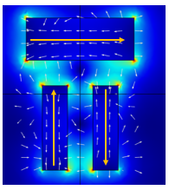
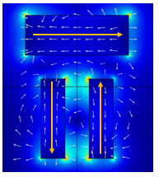
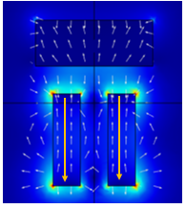
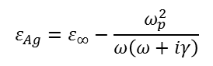
Dolmen nanoantenna
COMSOL model available on the website:
“QNM_Dolmen.mph’’
“QNM_Dolmen_sym.mph’’
or associated matlab files
Ag
air
Eigen electric field distributions
$$ε_{Ag}=ε_{∞}−\frac{ω_{p}^{2}}{ω\left(ω+iγ\right)}$$
Mode1
Mode2
Mode3
R. Faggiani, A. Losquin, J. Yang, E. Mårsell, A. Mikkelsen, P. Lalanne, ACS Photonics 4, 897-904 (2017).
"Modal analysis of the ultrafast dynamics of optical nanoresonators"
T. Wu, A. Baron, P. Lalanne, K. Vynck, Phys. Rev. A 101, 011803(R) (2020).
"Intrinsic multipolar contents of nanoresonators for tailored scattering"

Slide 7
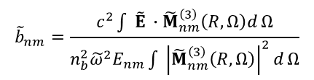
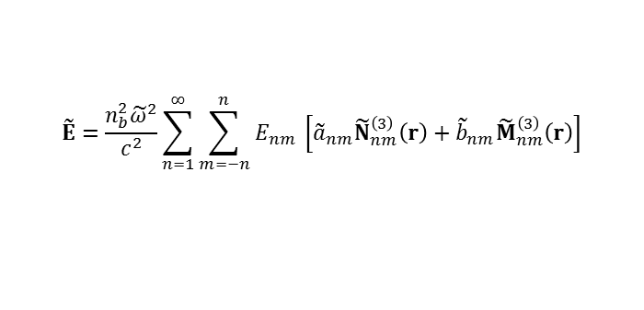
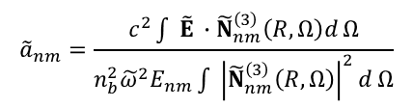
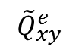
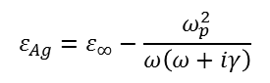
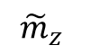
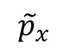
Multipolar decomposition of QNMs
$$ε_{Ag}=ε_{∞}−\frac{ω_{p}^{2}}{ω\left(ω+iγ\right)}$$
Contact: Tong WU tong.wu@institutoptique.fr or wutong1121@sina.com
COMSOL model available on the website:
“QNM_Dolmen.mph’’
“QNM_Dolmen_sym.mph’’
or associated matlab files
Ag
air
Main features:
Computation the multipolar decomposition in the vectorial spherical harmonics of a QNM at the complex frequency of the QNM
Provide multipolar decomposition that is intrinsic (excitation-independent) to the the nanoparticle
Avoid the traditional problem that a multipolar decomposition at real frequency excitation dependent, as it depends on the frequency, polarisation, incidence angle of the illumination
$${\tilde{a}}_{nm}=\frac{c^{2}\int{ \tilde{E} ∙{\tilde{N}}_{nm}^{\left(3\right)}\left(R, Ω\right)d}Ω}{{n_{b}^{2}\tilde{ω}}^{2}E_{nm}\int{ {\left|{\tilde{N}}_{nm}^{\left(3\right)}\left(R, Ω\right)\right|}^{2}d}Ω}$$
$${\tilde{p}}_{x}$$
$$\tilde{E}=\frac{{n_{b}^{2}\tilde{ω}}^{2}}{c^{2}}\sum_{n=1}^{∞}{\sum_{m=−n}^{n}{E_{nm} }\left[{\tilde{a}}_{nm}{\tilde{N}}_{nm}^{\left(3\right)}\left(r\right)+{\tilde{b}}_{nm}{\tilde{M}}_{nm}^{\left(3\right)}\left(r\right)\right]}$$
$${\tilde{m}}_{z}$$
$${\tilde{b}}_{nm}=\frac{c^{2}\int{ \tilde{E} ∙{\tilde{M}}_{nm}^{\left(3\right)}\left(R, Ω\right)d}Ω}{{n_{b}^{2}\tilde{ω}}^{2}E_{nm}\int{ {\left|{\tilde{M}}_{nm}^{\left(3\right)}\left(R, Ω\right)\right|}^{2}d}Ω}$$
$${\tilde{Q}}_{xy}^{e}$$
T. Wu, A. Baron, P. Lalanne, K. Vynck, Phys. Rev. A 101, 011803(R) (2020).
"Intrinsic multipolar contents of nanoresonators for tailored scattering"

Slide 8
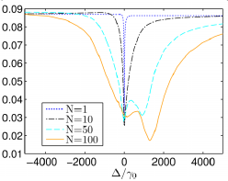
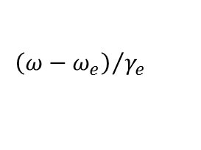
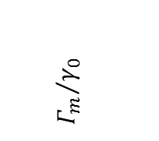
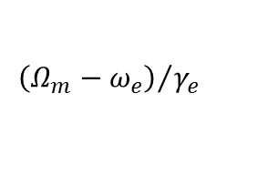
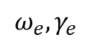
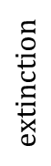
Superradiance of disordered ensembles of two-level resonators coupled by a plasmonic resonator
Ag
Contact: Philippe Lalanne<philippe.lalanne@institutoptique.fr>
Program to compute the superradiant and subradiant states of the coupled ensemble is available in PRB 95, 195418 (2017).
Driving field
$${ω_{e},γ}_{e}$$
Superradiant state
Plasmon-mediated
$${Γ_{m}}/{γ_{0}}$$
$$extinction$$
direct
$${\left(ω−ω_{e}\right)}/{γ_{e}}$$
$${\left(Ω_{m}−ω_{e}\right)}/{γ_{e}}$$
P. Fauché et al., Phys. Rev. B 95, 195418 (2017).
"Collective scattering in hybrid nanostructures with many atomic oscillators coupled to an electromagnetic resonance"

Slide 9
photonic microcavities and particles

Slide 10
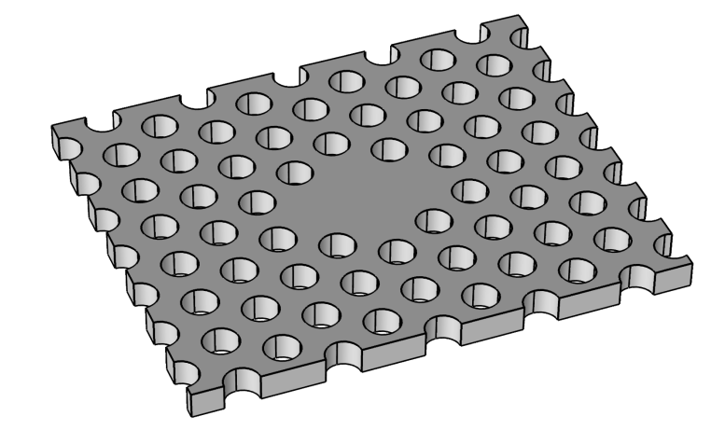
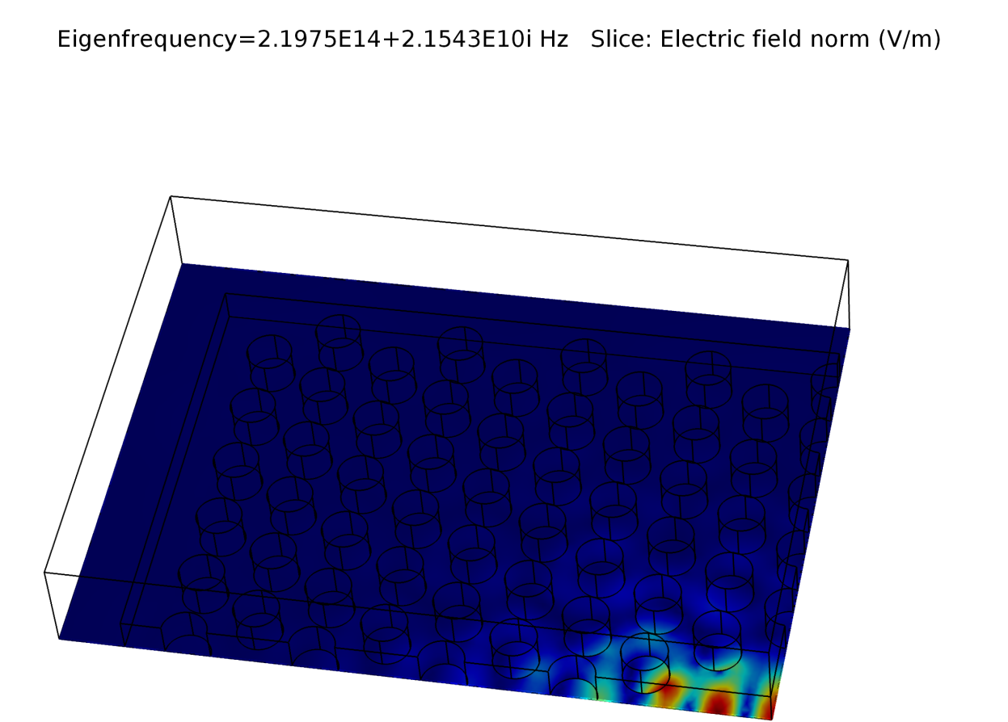
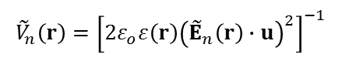
GaAs photonic crystal membrane in air
Contact: Wei Yan <yanwei@westlake.edu.cn>
air
COMSOL model available on the website:
“QNMEig_GaAsPhc.mph’’
GaAs
(no frequency dispersion)
Complex mode volume
$${\tilde{V}}_{n}^{ }\left(r\right)={\left[{2ε}_{o}ε\left(r\right){\left({\tilde{E}}_{n}\left(r\right)∙u\right)}^{2}\right]}^{−1}$$
K. G. Cognée et al., Optica 6, 269 (2019).
"Mapping Complex Mode Volumes with Cavity Perturbation Theory"

Slide 11
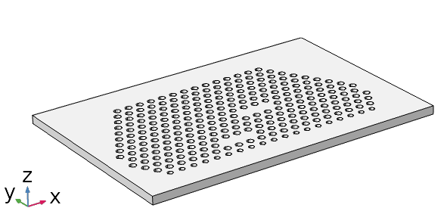
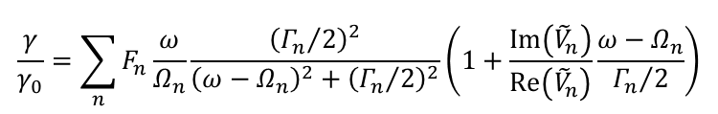
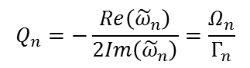
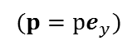
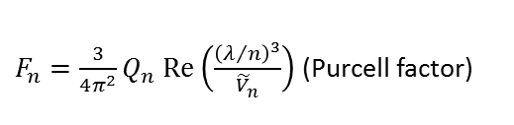
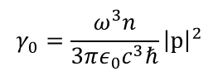
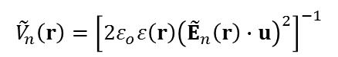
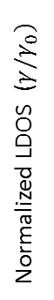
Coupled photonic crystal cavities: non-Lorentzian LDOS
$$(p=pe_{y})$$
Contact: Tong WU<tong.wu@institutoptique.fr>
COMSOL model available on the website:
“QNMEig_PhCcoupled.mph’’
November 2019
Normalized LDOS ($γ/γ_{0})$
$$\frac{γ}{γ_{0}}=\sum_{n}{F_{n}\frac{ω}{Ω_{n}}\frac{{\left({Γ_{n}}/2\right)}^{2}}{{\left(ω−Ω_{n}\right)}^{2}+{\left({Γ_{n}}/2\right)}^{2}}\left(1+\frac{Im\left({\tilde{V}}_{n}^{ }\right)}{Re\left({\tilde{V}}_{n}^{ }\right)}\frac{ω−Ω_{n}}{{Γ_{n}}/2}\right)}$$
$F_{n}=\frac{3}{4π^{2}}Q_{n} Re\left(\frac{{\left(λ/n\right)}^{3}}{{\tilde{V}}_{n}^{ }}\right)$ (Purcell factor)
n_air=1
n_slab=3.484
$${\tilde{V}}_{n}^{ }\left(r\right)={\left[{2ε}_{o}ε\left(r\right){\left({\tilde{E}}_{n}\left(r\right)∙u\right)}^{2}\right]}^{−1}$$
$$Q_{n}=−\frac{Re\left({\tilde{ω}}_{n}\right)}{2Im\left({\tilde{ω}}_{n}\right)}=\frac{Ω_{n}}{Γ_{n}}$$
Cavity 2
Cavity 1
$$γ_{0}=\frac{ω^{3}n}{3πε_{0}c^{3}ℏ}{\left|p\right|}^{2}$$
D. Pellegrino et al., Phys. Rev. Lett. 124, 123902 (2020)
"Non-Lorentzian Local Density of States in Coupled Photonic Crystal Cavities Probed by Near- and Far-Field Emission"

Slide 12
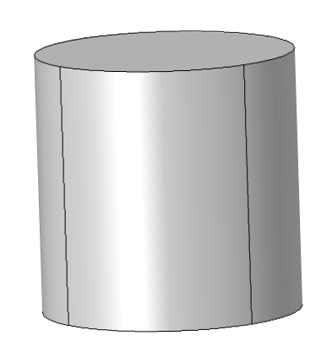
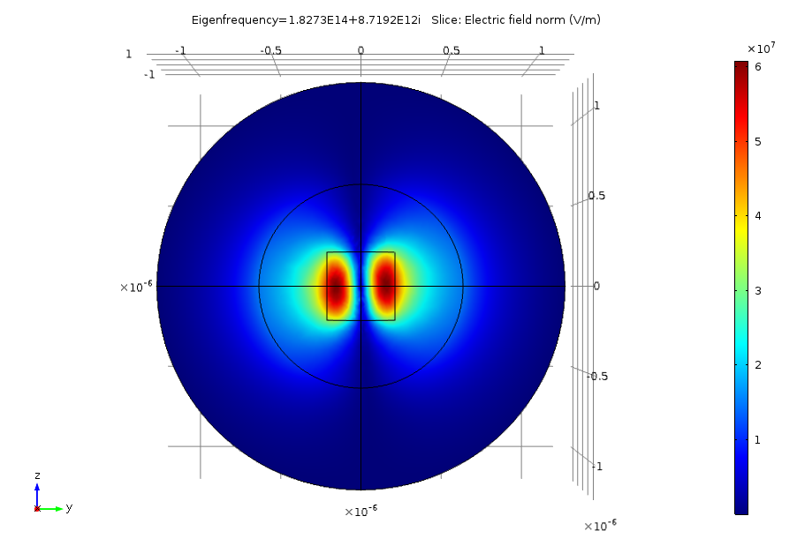
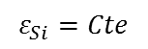
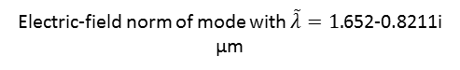
Semiconductor nanorod in air
Contact: Alexandre Gras <alexandre.gras@institutoptique.fr>
COMSOL model available on the website:
“QNMEig_Nanorod.mph’’
January 2019
air
Si
$$ε_{Si}=Cte$$
Electric-field norm of mode with $\tilde{λ}=1.$652-0.8211i µm
The extinction computed with the QNM-expansion is obtained with the toolbox QNMEig_toolbox_1 for an incident plane wave that propagates parallel to the rod axis.
Notes:
Developed by Wei Yan (2018)

Slide 13
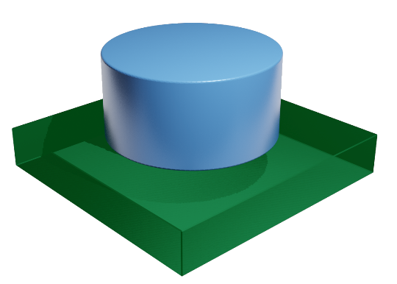
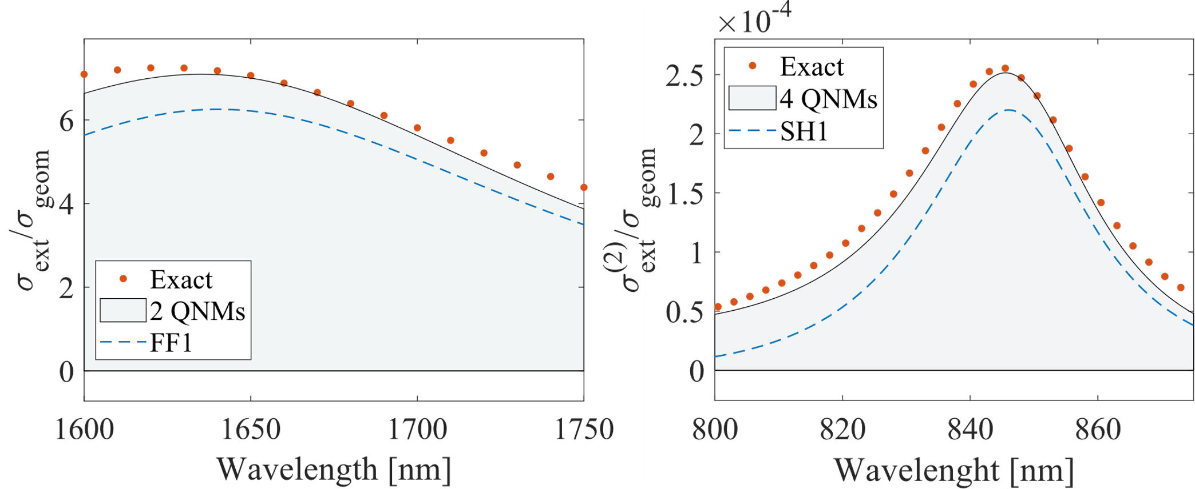
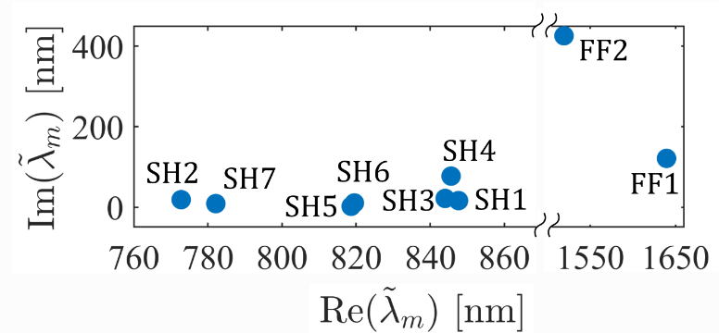
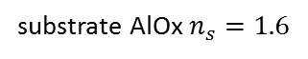

Nonlinear generation in dielectric nanoparticles on substrate
Contact: Carlo Gigli <carlo.gigli@u-paris.fr>
AlGaAs $ε(ω)=ε_{∞}\left(1−\frac{ω_{p}^{2}}{ω^{2}−ω_{0}^{2}+iγω}\right)$
COMSOL model available on the website:
“QNMEig_NLnanodisk.mph’’
March 2020
Main features:
Computation of linear and nonlinear scattering efficiencies by a nanoresonator on a substrate
Analysis of mode contribution to the scattering
Study of nonlinear overlap integral and phase matching conditions
substrate AlOx $n_{s}=1.6$
C. Gigli, T. Wu, G. Marino, A. Borne, G. Leo, and P. Lalanne, arXiv 1911.06373 (2019) & ACS Photonics (2020).
"Quasinormal-mode modeling and design in nonlinear nano-optics"

Slide 14
gratings and crystals

Slide 15



2D plasmonic crystal
air
Contact: Wei Yan <yanwei@westlake.edu.cn>
COMSOL model available on the website:
“QNMEig_PlasmCrystal.mph’’
Ag
y
x
QNMs are computed and normalized for in plane parallel momentum k//.
Eigenmode k_{x}=0.5
P. Lalanne, W. Yan, A. Gras, C. Sauvan, J.-P. Hugonin, M. Besbes, G. Demesy, M. D. Truong, B. Gralak, F. Zolla, A. Nicolet, F. Binkowski, L. Zschiedrich, S. Burger, J. Zimmerling, R. Remis, P. Urbach, H. T. Liu, T. Weiss, J. Opt. Soc. Am. A 36, 686 (2019).
"Quasinormal mode solvers for resonators with dispersive materials"
Notes:
Developed by Alexandre Gras (2018)

Slide 16


2D periodic slit array in a silver membrane in air
Contact: Alexandre Gras <alexandre.gras@institutoptique.fr>
COMSOL model available on the website:
“QNMEig_1DGrating.mph’’
Ag
air
P. Lalanne, W. Yan, A. Gras, C. Sauvan, J.-P. Hugonin, M. Besbes, G. Demesy, M. D. Truong, B. Gralak, F. Zolla, A. Nicolet, F. Binkowski, L. Zschiedrich, S. Burger, J. Zimmerling, R. Remis, P. Urbach, H. T. Liu, T. Weiss, J. Opt. Soc. Am. A 36, 686 (2019).
"Quasinormal mode solvers for resonators with dispersive materials"
Notes:
Developed by Wei Yan (2018)

Slide 17





2D grating with grooves on a gold substrate with fixed incidence angle
Contact: Alexandre Gras <alexandre.gras@institutoptique.fr>
COMSOL model available on the website:
“QNMEig_grating_theta.mph’’
Ag
The specificity of the model is that QNMs are computed and normalized for a fixed angle of incidence $θ$, which is exactly what is happening in many experiment: the wavelength is scanned while $θ$ is maintained constant.
Normalized $|{\tilde{H}}_{z}|$ of mode at ${\tilde{λ}}_{m}=714.8+39.0i nm$
for $θ=30°$
$θ=30°$ incidence
A. Gras, W. Yan and P. Lalanne, Opt. Lett. 44, 3494 (2019).
"Quasinormal-mode analysis of grating spectra at fixed incidence angles"
Notes:
Developed by Wei Yan (2018)

Slide 18
Under preparation, models for
Bowtie nanoantenna on substate

